Slide 1
Graphs
CSI 219 – Discrete Mathematics

Slide 2
Graph connectivity

Slide 3
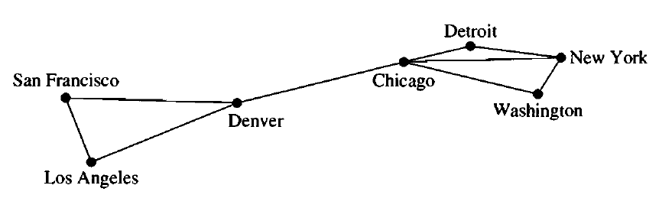
Path and circuit
A path is a sequence of edges that begins at a vertex of a graph and travels from vertex to vertex along edges of the graph.
There is a path from SF to NY
The path length is 3

Slide 4
Path and circuit
The path is a circuit if it begins and ends at the same vertex, that is, if
u = v, and has length greater than zero.
There is a circuit from Detroit to Detroit via NY, Washington and Chicago
The cycle length is 4

Slide 5
Path and circuit
Is SF-Denver-Chicago-Denver-LA a path from SF to LA?
Is Denver-Chicago-Denver a circuit from Denver to Chicago?

Slide 6
Simple path and simple circuit
A path with no repeated edge is a simple path
A circuit with no repeated edge is a simple circuit

Slide 7
Connectedness in undirected graphs

Slide 8
Connected graph
An undirected graph is called connected if there is a path between every pair of distinct vertices of the graph. An undirected graph that is not connected is called disconnected.
We can reach any vertex from any other vertex in this graph
This graph is a connected graph

Slide 9
Connected graph
We cannot reach LA from NY
So the graph is not connected

Slide 10
Connected components
A connected component of a graph G is a maximal connected subgraph of G.
We can communicate between LA, SF and Denver
We can communicate between Detroit, NY, Chicago and Washington
These are connected components

Slide 11
Connectedness in directed graphs

Slide 12
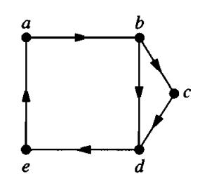
Strongly connected graph
A directed graph is strongly connected if there is a path from a to b and from b to a whenever a and b are vertices in the graph.

Slide 13
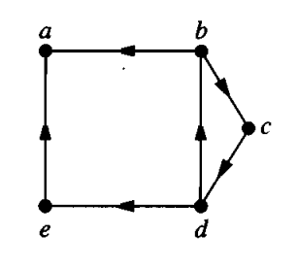
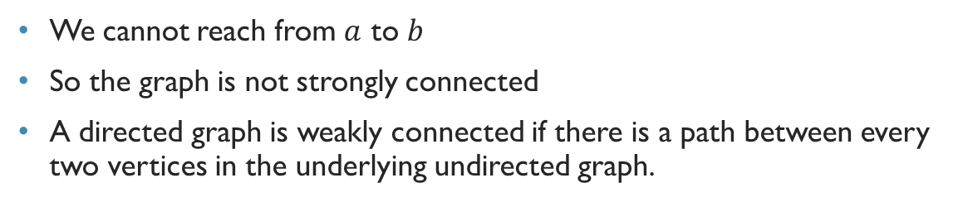
Weakly Connected graph
We cannot reach from $a$ to $b$
So the graph is not strongly connected
A directed graph is weakly connected if there is a path between every two vertices in the underlying undirected graph.

Slide 14
Weakly Connected graph
We say a directed graph is weakly connected if its underlying undirected graph is connected.

Slide 15
Strongly connected components
The subgraphs of a directed graph G that are strongly connected but not contained in larger strongly connected subgraphs, that is, the maximal strongly connected subgraphs, are called the strongly connected components or strong components of G.

Slide 16
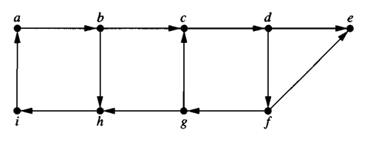
Exercise
Find out strongly connected components of this graph:

